Slide 1
Cross-modality Training to Learn Cardiac Motion Flow in Steady-state Free Precession MRI

Slide 2
Goal
Improve motion estimation in Steady-state Free Precession (SSFP) MRI by leveraging models learned under cross-modality supervision of Displacement Encoding with Simulated Echos (DENSE) data
Intuition is that feature representations learned from DENSE will support more accurate motion estimation and segmentation

Slide 3
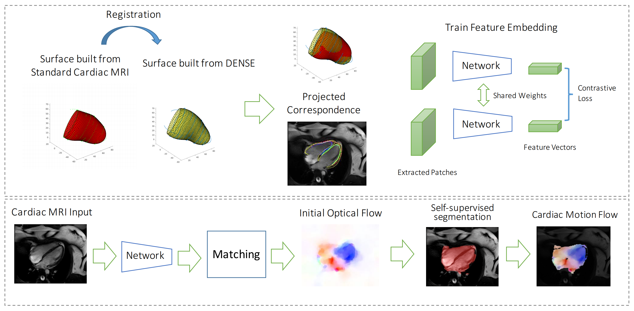
Overall Workflow

Slide 4
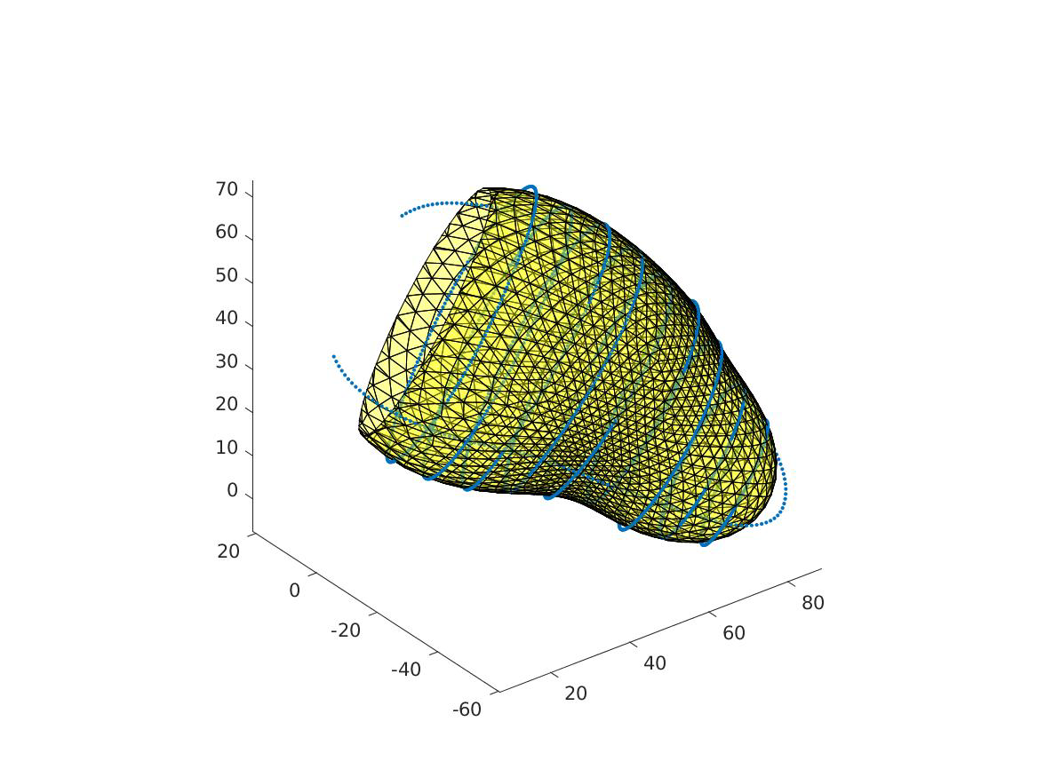
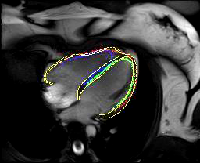
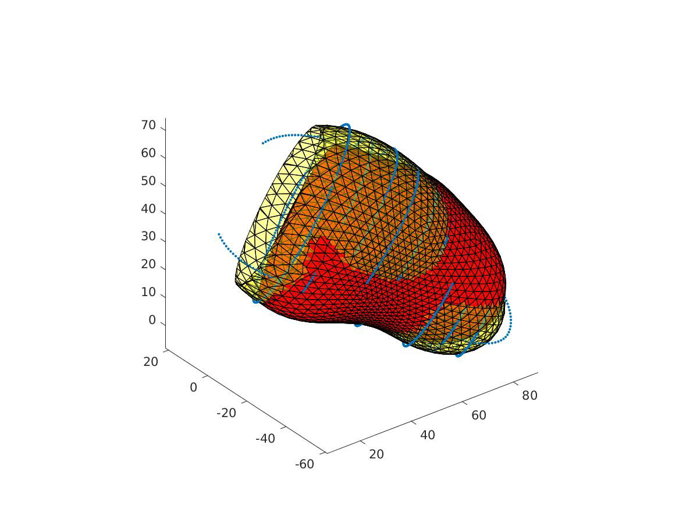
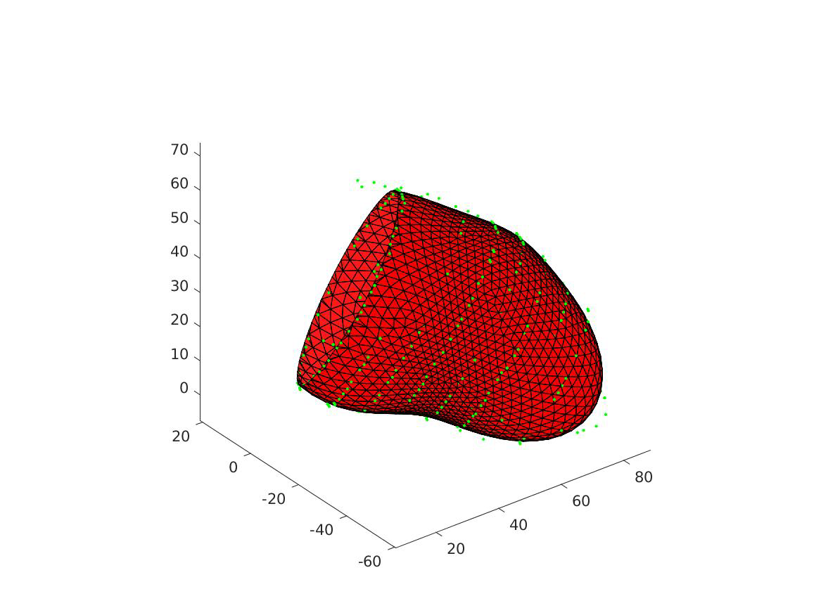
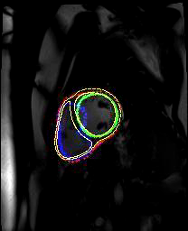
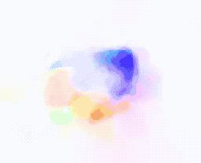
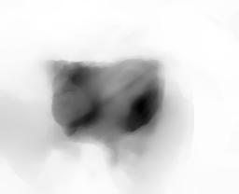
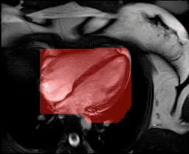
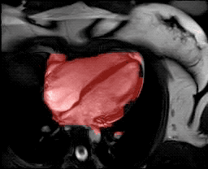
Major Contributions
Overall we present the first learning based approach to estimate cardiac motion.
For each individual step:
We present a solution to register SSFP modality with DENSE modality data.
To overcome the sparse supervision from limited samples, we present a feature learning scheme and dense association algorithm which makes the learning process feasible.
We present an manual-free approach to segment the cardiac region by bootstrapping the attention from cardiac motion representation we learned.
Shared Weights
Contrastive Loss
Feature Vectors
Extracted Patches

Slide 5
Spatial-temporal registration for SSFP and DENSE

Slide 6
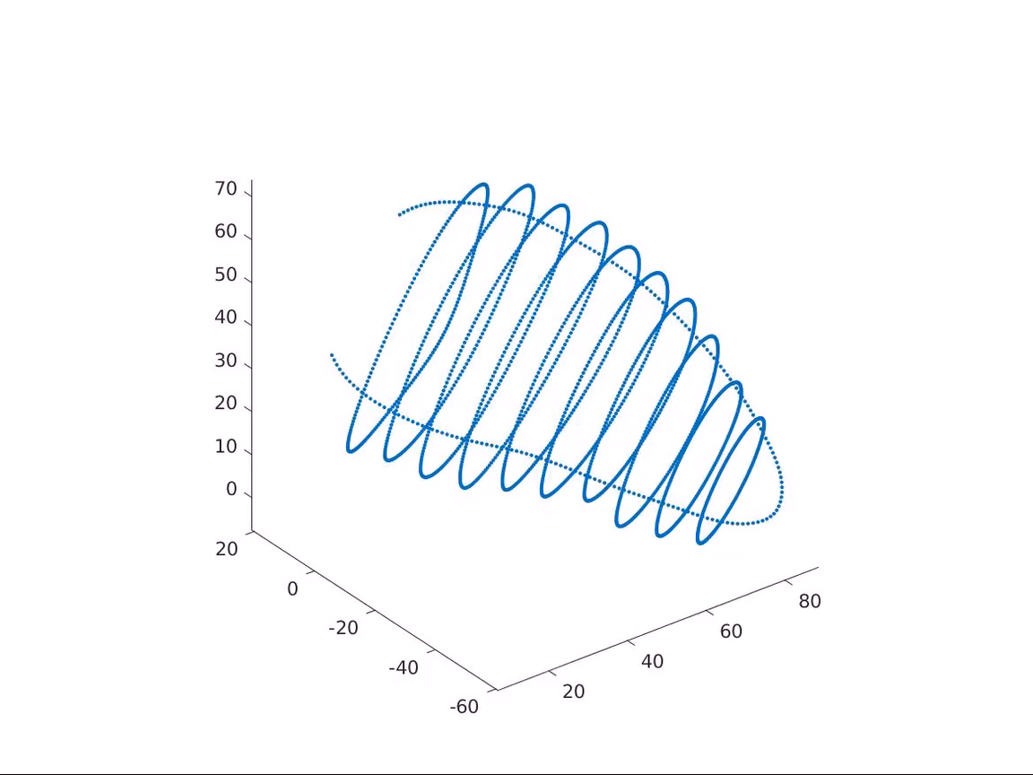
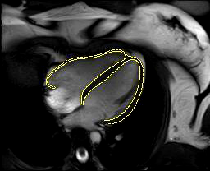
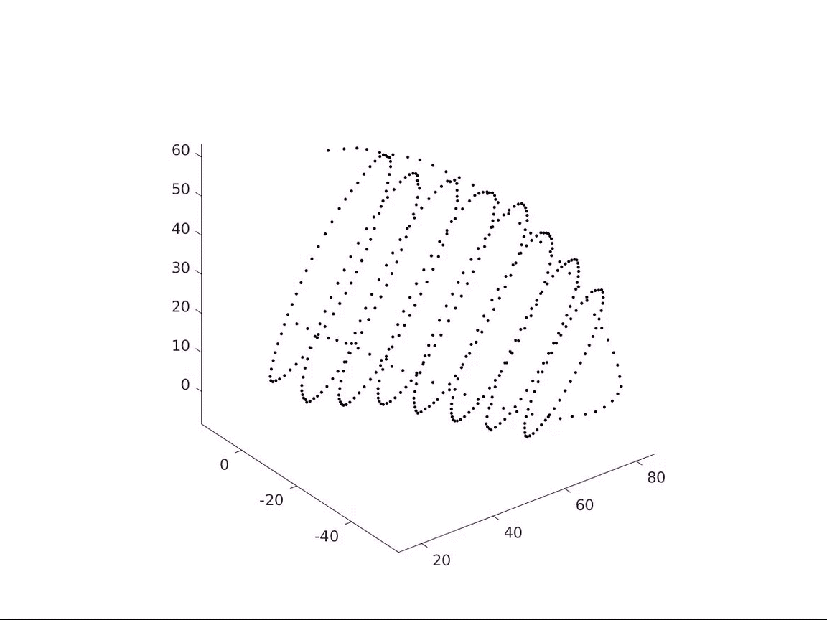
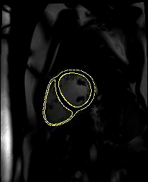
3D Cardiac Contours from annotated 2D cardiac images
Examples for SSFP 2D annotations
DENSE contours
(annotate with entire cycle)
SSFP contour
(annotate only the first frame)
Annotations in the first frame is sufficient for us to solve the rigid transform between the two modalities .

Slide 7

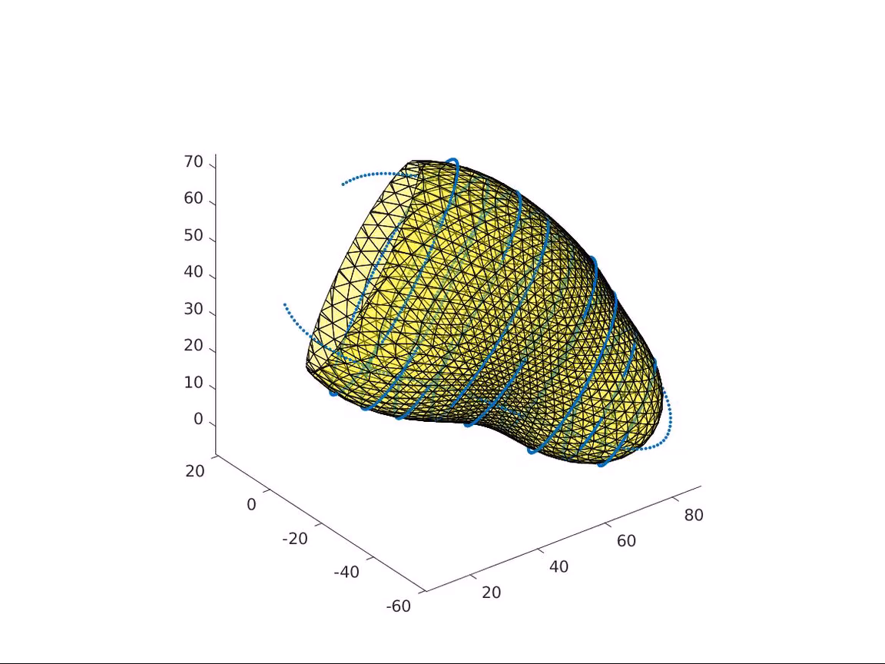
Construct the surface mesh from contours
DENSE contours
(annotate with entire cycle)
SSFP contour
(annotate only the first frame)

Slide 8
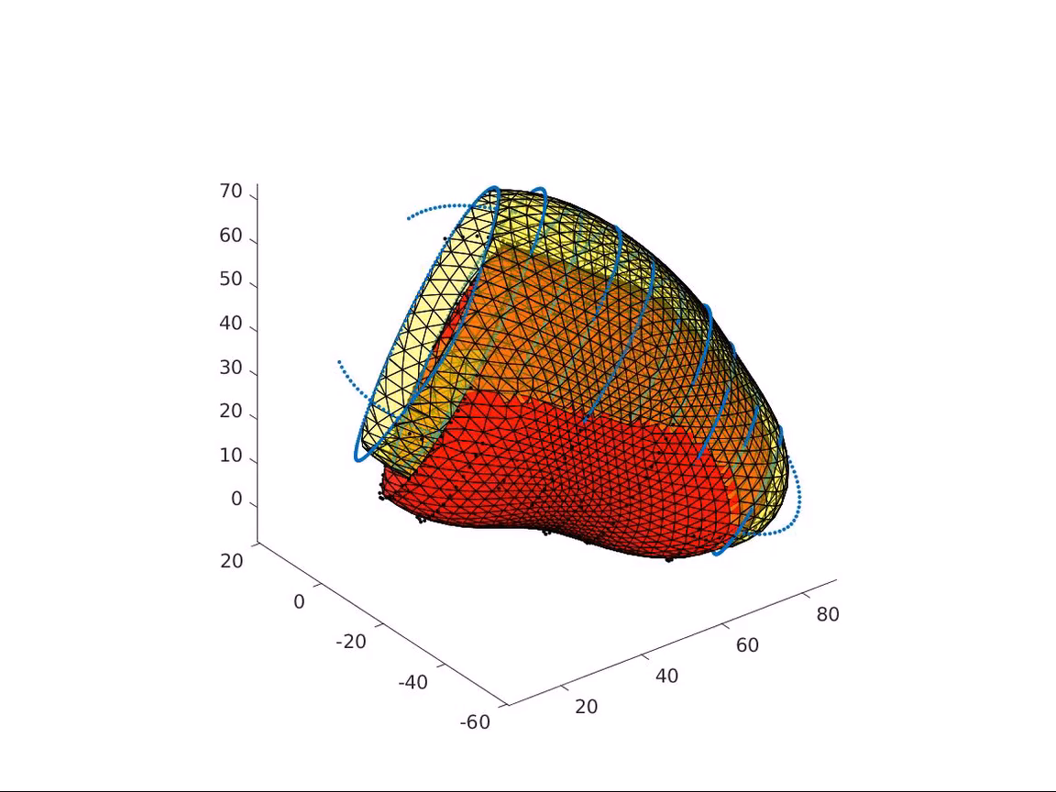
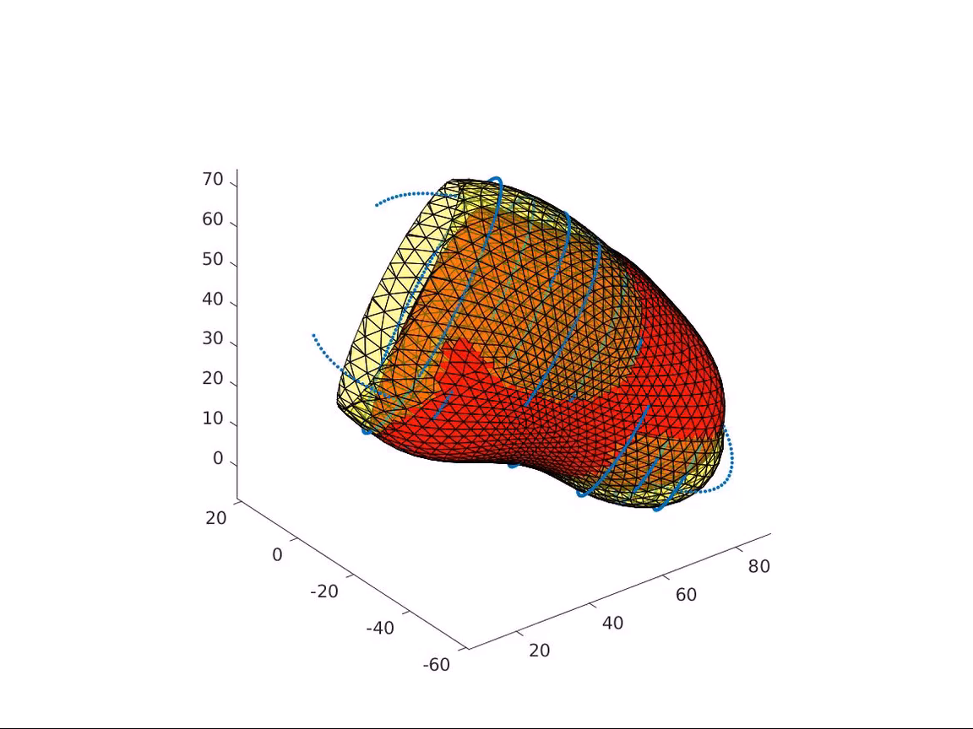
Before registration
The surfaces of SSFP and DENSE in the same coordinate
After spatial-temporal registration
Surface constructed from DENSE is in RED
Surface constructed from SSFP is in Yellow

Slide 9
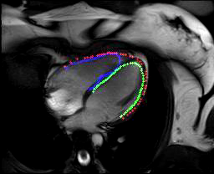
One Example of Projected Correspondences Projected DENSE contours are used as ground truth correspondence for flow training.
Annotated Contour
in SSFP (yellow)
Project registered
DENSE into SSFP
Overlay
Comparison

Slide 10
Learn feature embedding in SSFP with DENSE correspondence

Slide 11
Challenges in learning correspondence
Supervised signal is too sparse in each sample: we have very limited amount of motion correspondence (only along the contours) from the two registered surfaces.
Number of total samples is limited: we have DENSE data for only 50 subjects.
Such limitation is a significant constraint in cardiac applications.

Slide 12
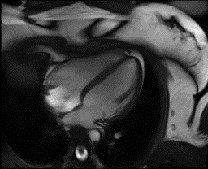
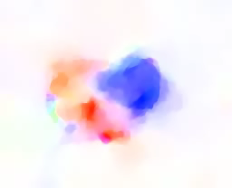
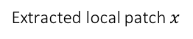
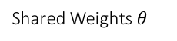
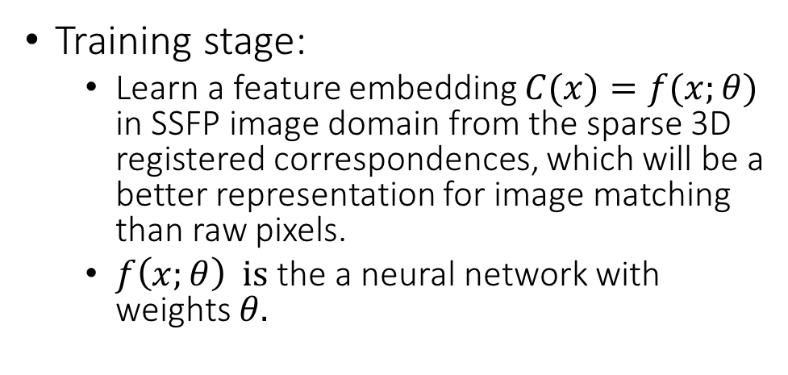
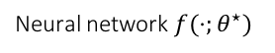
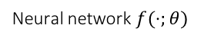
Two-stage approach to solve correspondence
Training stage:
Learn a feature embedding $C(x)=f(x;θ)$ in SSFP image domain from the sparse 3D registered correspondences, which will be a better representation for image matching than raw pixels.
$f\left(x;θ\right) is$ the a neural network with weights $θ.$
Neural network $f(⋅;θ)$
Shared Weights $θ$
Contrastive Loss
Feature Vectors
Extracted local patch $x$
Inference stage:
SSFP raw input (HxW)
Dense flow correspondence
Neural network $f(⋅;θ^{⋆})$
Feature volume for each pixel (CxHxW)
Correspondence
matching

Slide 13
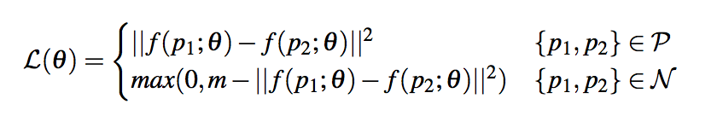
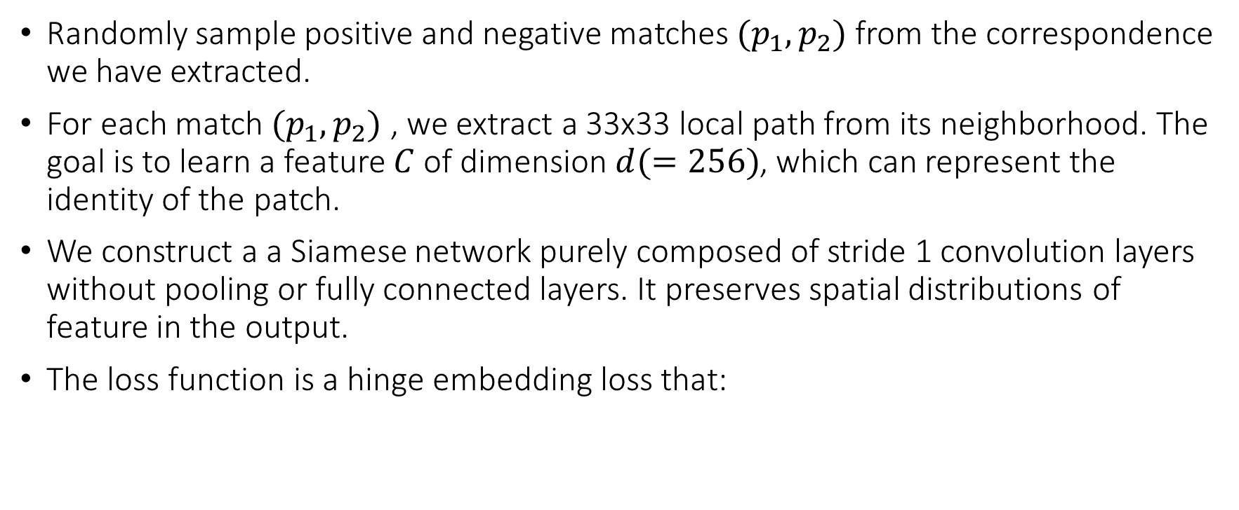
Train stage
Randomly sample positive and negative matches $(p_{1}, p_{2})$ from the correspondence we have extracted.
For each match $(p_{1}, p_{2})$ , we extract a 33x33 local path from its neighborhood. The goal is to learn a feature $C$ of dimension $d(=256)$, which can represent the identity of the patch.
We construct a a Siamese network purely composed of stride 1 convolution layers without pooling or fully connected layers. It preserves spatial distributions of feature in the output.
The loss function is a hinge embedding loss that:

Slide 14
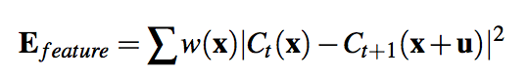
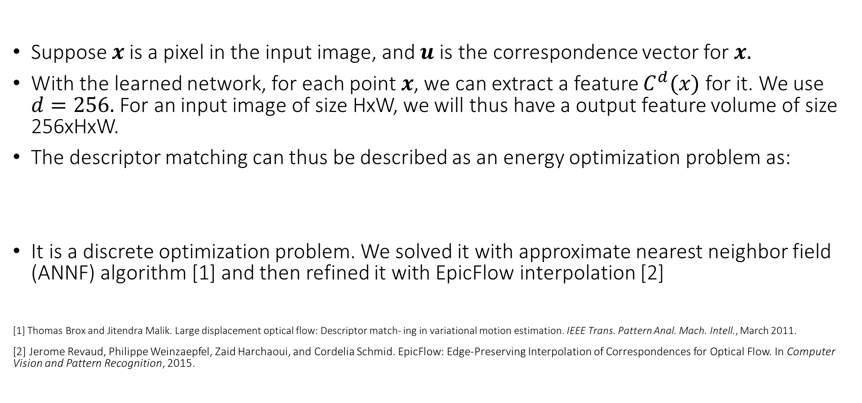
Inference stage
Suppose $x$is a pixel in the input image, and $u$ is the correspondence vector for $x.$
With the learned network, for each point $x$, we can extract a feature $C^{d}(x)$ for it. We use $d=256.$For an input image of size HxW, we will thus have a output feature volume of size 256xHxW.
The descriptor matching can thus be described as an energy optimization problem as:
It is a discrete optimization problem. We solved it with approximate nearest neighbor field (ANNF) algorithm [1] and then refined it with EpicFlow interpolation [2]
[1] Thomas Brox and Jitendra Malik. Large displacement optical flow: Descriptor match- ing in variational motion estimation. IEEE Trans. Pattern Anal. Mach. Intell., March 2011.
[2] Jerome Revaud, Philippe Weinzaepfel, Zaid Harchaoui, and Cordelia Schmid. EpicFlow: Edge-Preserving Interpolation of Correspondences for Optical Flow. In Computer Vision and Pattern Recognition, 2015.

Slide 15
Quantitative evaluation
We compare to two state-of-art non-learning based optical flow methods. We use the same correspondence solver in their algorithm, by replace their feature embedding with our learned embedding. And evaluate them as below:
 | Endpoint-error (EPE) | Angular Error (AE)
LDOF [1] | 0.7812 | 0.5753
Our feature matching + variational inference | 0.7434 | 0.5471
Our feature matching (no optimization) | 1.174 | 0.610
 | Endpoint-error (EPE) | Angular Error (AE)
EpicFlow [2] | 0.6719 | 0.4635
Our feature matching + epic | 0.6180 | 0.4333
Our feature matching (no optimization) | 1.174 | 0.610
Note:
Variational Inference is used in LDOF [1] to solve correspondence matching problem.
EpicFlow [2] uses interpolation algorithm to solve dense correspondence matching problem.

Slide 16
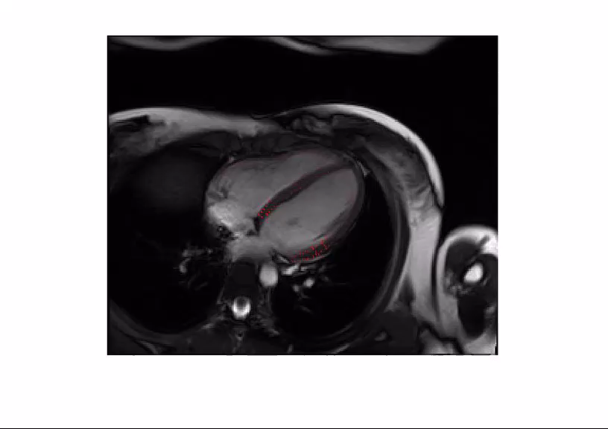
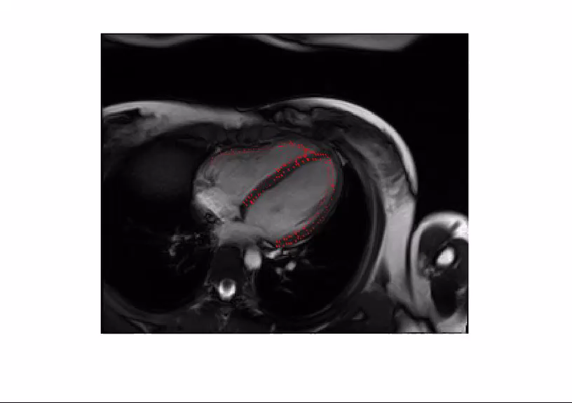

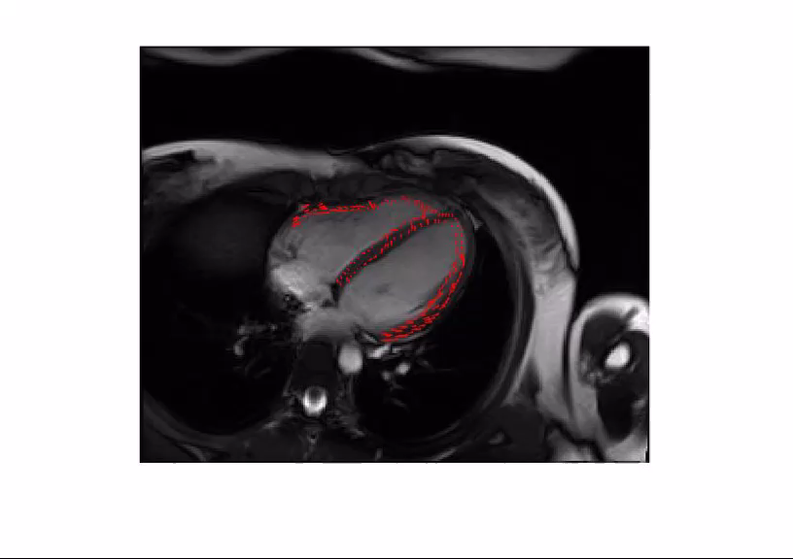
Flow Vector Visualization Comparison Ground truth extracted from projected contour correspondence
Using LDOF[1]
Using EpicFlow[2]
Using Our
Learned flow
Ground truth

Slide 17
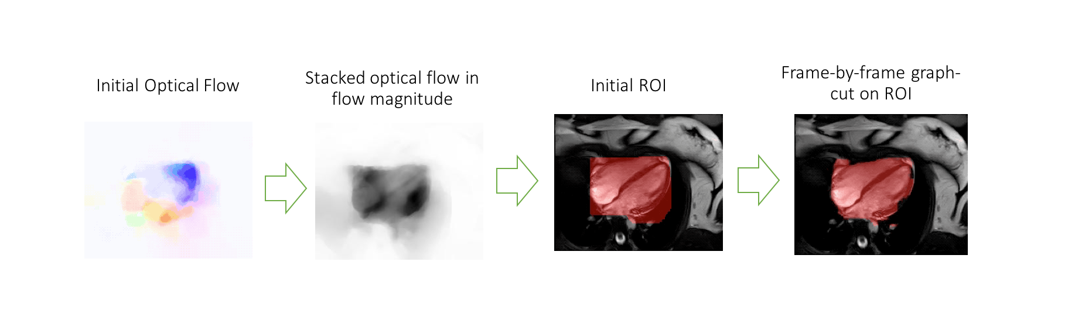
Cardiac Region Segmentation from Motion Flow
The learned feature embedding has one problem:
No background information is used in training. Thus the predicted feature embedding in the background region can be quite noisy.
If we can extract the attention of cardiac motion and subtract it, we can remove the effect of noisy background.

Slide 18
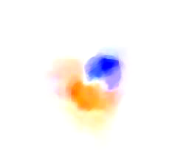
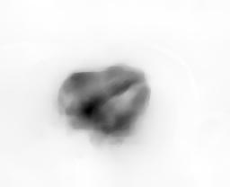
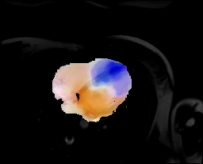
Segmented Cardiac Flow Video Visualization
Initial estimated flow
Aggregated flow ROI
Segmented cardiac flow

Slide 19
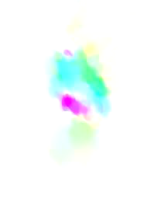
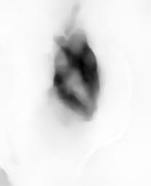
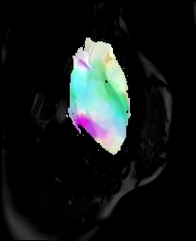
Segmented Cardiac Flow Video Visualization
Initial estimated flow
Aggregated flow ROI
Segmented cardiac flow

Slide 20
Conclusions
We observe that the quite a few cardiac motion between frames are significant small (<1 pixel) displacement. Our discrete pixel-level matching representation learning only learn similar patches at integer displacement, which limits more accurate motion inference.
Myocardium moves in 3D, but MRI only catches signal in the 2D planes, its flow correspondence problem is genuinely difficult to be estimated in the 2D image plane. In the future, we will try to approach more in the 3D domain.

